Slide 1
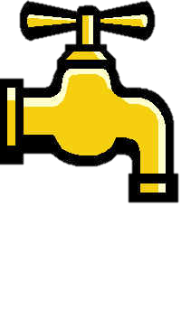
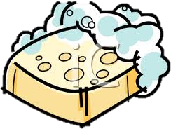
HOW IS WATER DRIPPING ON A BAR OF SOAP LIKE WEATHERING AND EROSION?
Weathering:
Water dripping breaks the soap into smaller pieces
Water also moves the soap pieces down the drain.
Erosion:

Slide 2
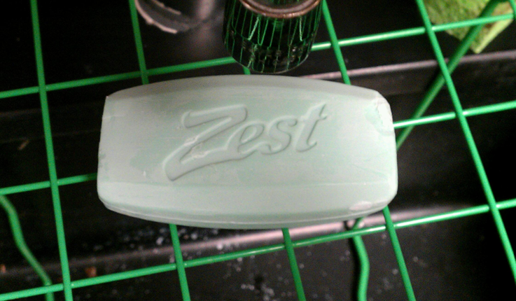
What will happen if we let the water drip on the soap over night?

Slide 3
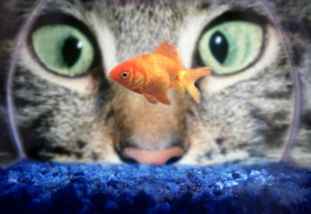
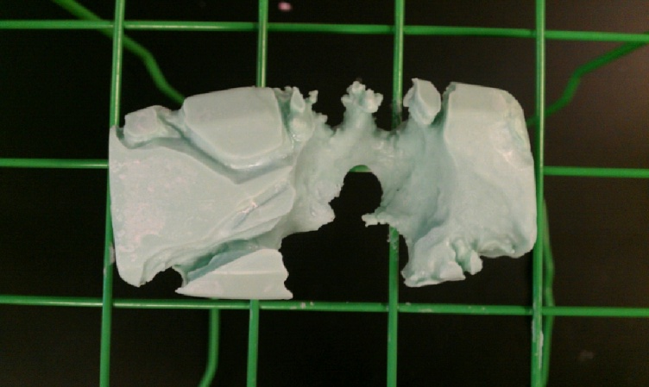
Let’s see and find out!
Next day

Slide 4
Apply the Scientific Method
Observation- I observe evidence of weathering on rocks.
Question- I wonder if a bar of soap would weather like a rock.
Hypothesis- If I let water drip on a bar of soap over night, then the water will wear a hole in the soap.
Experiment- Place a new bar of soap under the faucet and let the water drip over night. Record data and check if the hypothesis was correct. Repeat until results are consistent.

Slide 5
Data
Start time/ date | 10/12/15 5:00 pm
End time/date | 10/13/15 8:00am
Total time | 15 hours, or 900 minutes, or 54000 seconds
Drops per minute | 52 dpm
Drops per hour | 3120 dph
Drops total | 46,800
Conclusion- Yes, water dripping on a bar of soap will act as weathering does to a rock, only it happens much more quickly than to a real rock.
Communicate results- I am sharing my information with you!

