Slide 1
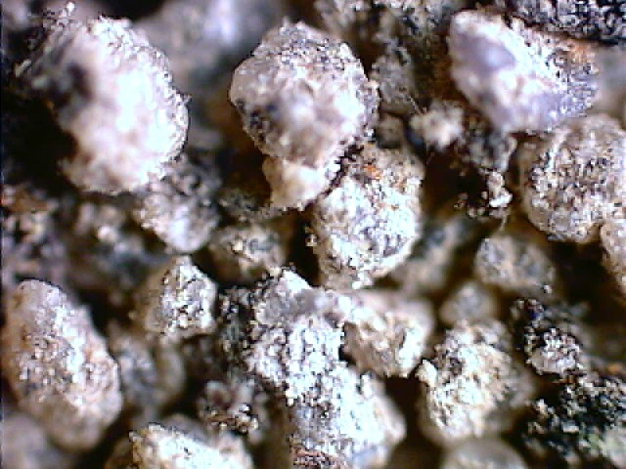
Soils:
One of Our
Natural Resources!

Slide 2
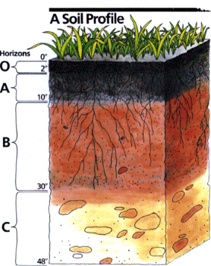
Soil Profile
In a cross-section of soil, various zones are formed.

Slide 3
A Horizon: Topsoil
This layer is usually loose and crumbly with varying amounts of organic matter.

Slide 4
A Horizon: Topsoil
This is generally the most productive layer of the soil.
Conservation efforts are focused here!

Slide 5
B Horizon: Subsoils
Subsoils are usually lighter in color, dense and low in organic matter.

Slide 6
C Horizon: Transition
This layer of transition is almost completely void of organic mater and is made up of partially weathered parent material.

Slide 7
Bedrock
Below the C horizon the unweathered bedrock will be found.

