Slide 1
WEATHERING, EROSION, DEPOSITION
Earth Science

Slide 2
Weathering
The breakdown of rock by physical and chemical processes is called weathering.
There are two types of weathering.
Physical Weathering
Chemical Weathering

Slide 3
Tell me more about these two types of weathering.

Slide 4
Two Types of Weathering
1. Physical Weathering
This is the process by which rock is broken down into smaller pieces by a physical change.
Physical Changes are temperature changes, pressure changes, plant and animal actions, water, wind, and gravity.
These physical changes cause the rocks to break down into smaller rocks.
2. Chemical Weathering
This is the breakdown of rocks by chemical reactions.
This changes the composition, or chemical makeup, of rocks.

Slide 5
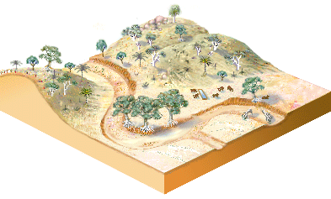
Erosion
Occurs when water or wind loosens rock and soil and carries it away.

Slide 6
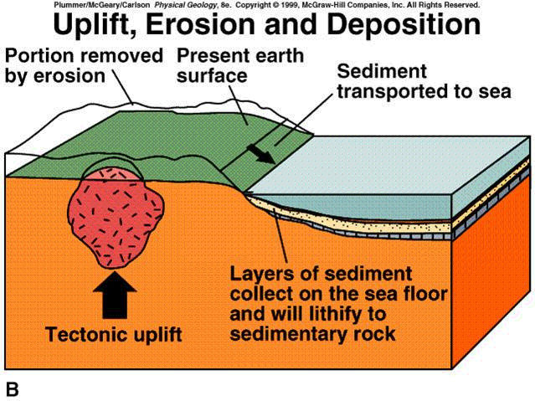
Deposition
The process by which the sediment settles out of the water or air carrying it.
Sediment is deposited when the wind or water slows down.
This is the laying down or settling of eroded material.

