Slide 1
Minerals
S6E5. Obtain, evaluate, and communicate information to show how Earth’s surface is formed.
b. Plan and carry out an investigation of the characteristics of minerals and how minerals contribute to rock composition.

Slide 2
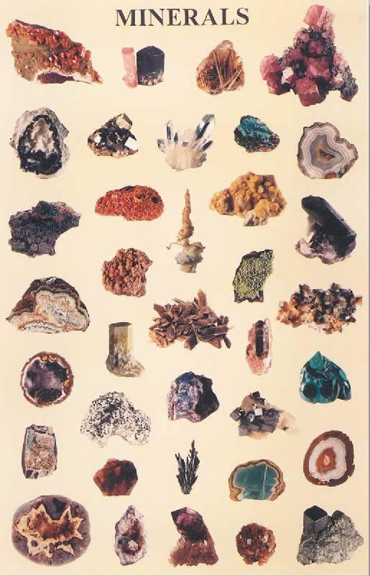
Minerals
Naturally occurring
Inorganic solid
Crystal structure
Definite chemical composition

Slide 3
What is a Mineral?
Most minerals look like rocks, so are minerals rocks?
Not really, as rocks are made of minerals, but minerals are not made of rocks.
A mineral is a naturally occurring usually inorganic solid that has a definite crystalline structure and chemical composition.

Slide 4
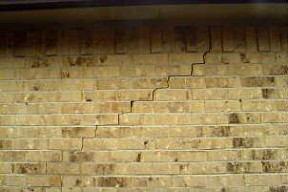
Naturally Occurring
Minerals must occur naturally.
Cannot be man made.
Cement, bricks, steel, and glass all come from materials found in the earth, but these are made by people.

Slide 5
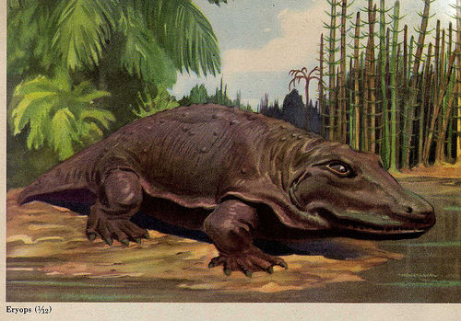
Inorganic
Inorganic materials were never living.
Coal is made from the remains of ancient plants and animals, so coal is not a mineral.

Slide 6
Solid
The state of matter when the material is Definite shape, definite volume.
Matter is anything with volume and mass.
Particles are fixed in place.
Does not take the shape of the container.

Slide 7
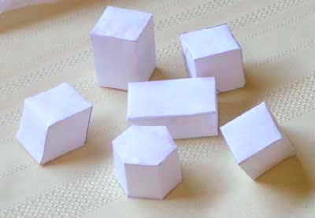
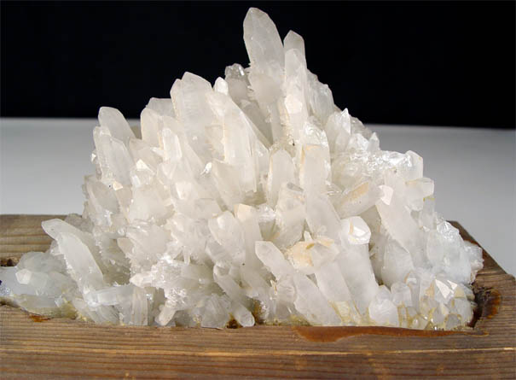
Crystal Structure
Minerals have crystal structure because they are made of crystals.
The particles of the material line up in a regular, repeating pattern.
Has flat sides called faces, that meet at sharp edges and corners.

Slide 8
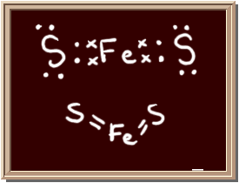
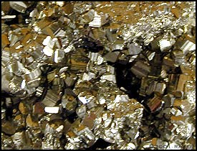
Definite Chemical Composition
Always contains certain elements in the same proportion.
Almost all minerals are compounds, which are two or more different elements bonded together (holding hands).
Pyrite is two sulfur atoms holding hands with an atom of iron.

Slide 9
Chemical Formula’s
Have a definite format.
Written together means they are bonded.
Coefficients tell how many of the whole thing you have.
Subscripts tell how many of the atom before it that you have.
So 2H means two separate hydrogen atoms.
H₂ mean two hydrogen atoms holding hands.
H₂O means two hydrogen atoms holding hands with an oxygen atom.

Slide 10
Identifying Minerals
Each mineral has specific properties that can be used to identify it.
Hardness
density
luster
color
streak
crystal system
cleavage and fracture
special properties

Slide 11
Hardness
A measure of how easily a mineral can be scratched.
Determined by the atomic structure of the mineral.
Friedrich Mohs developed the scale we use today.

Slide 12
Density
Minerals will have a certain density regardless of the size of the sample.
When geologists compare the weight of the mineral to the weight of an equal volume of water it is called specific gravity.

Slide 13
Color
Not especially useful in identifying minerals, as some minerals like quartz can come in a variety of colors.
Impurities and weathering can change the color of a mineral, so color is not the best way to identify a mineral.

Slide 14
Luster
The way a mineral reflects light.
Can be metallic or non-metallic.
Shiny or dull.
Earthy, waxy, pearly, glassy.

Slide 15
Streak
The color of its powder.
Not always the same as the color of the mineral.
Pyrite has a gold color, but its streak is a greenish black.
Much more reliable than color.

Slide 16
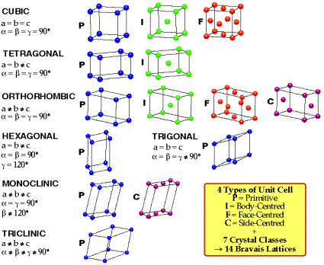
Crystal System
Six groups based on number and angle of the faces.
Example: Halite is cubic, as it always forms perfect cubes.

Slide 17
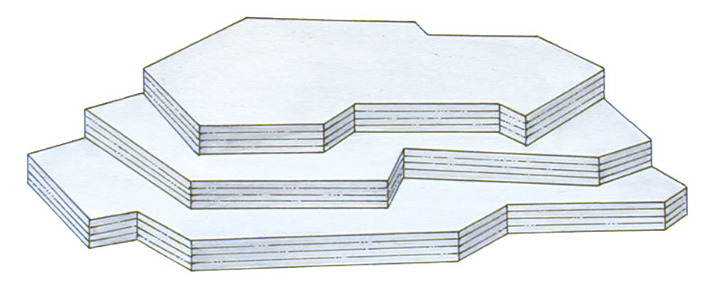
Cleavage
The way a mineral breaks apart.
If it splits easily along flat surfaces the property is cleavage.

Slide 18
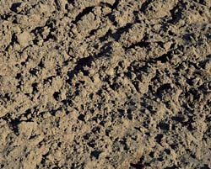
Fracture
A mineral fractures if it breaks in a random or irregular pattern.
A dirt clod fractures!
When a mineral fractures it just crumples into small pieces.

Slide 19
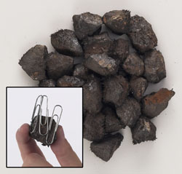
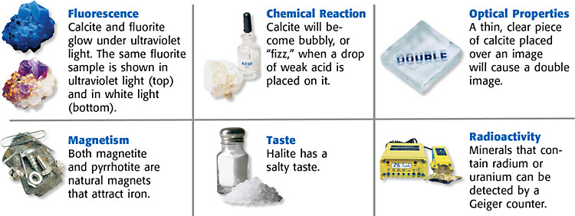
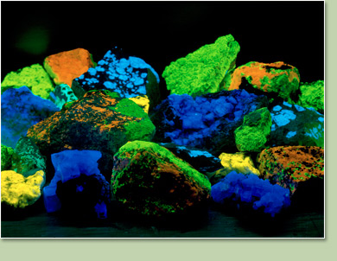
Special Properties
Some minerals have a property known as fluorescence, which means they glow under UV light.
Others are magnetic, radioactive or have electrical properties.

